Slide 1
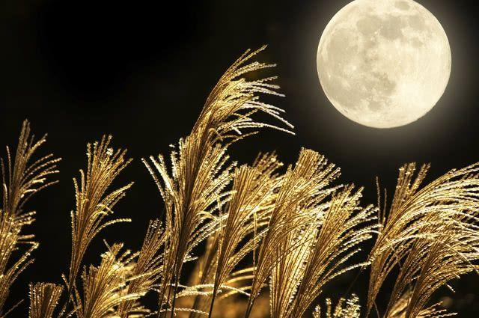

Slide 2
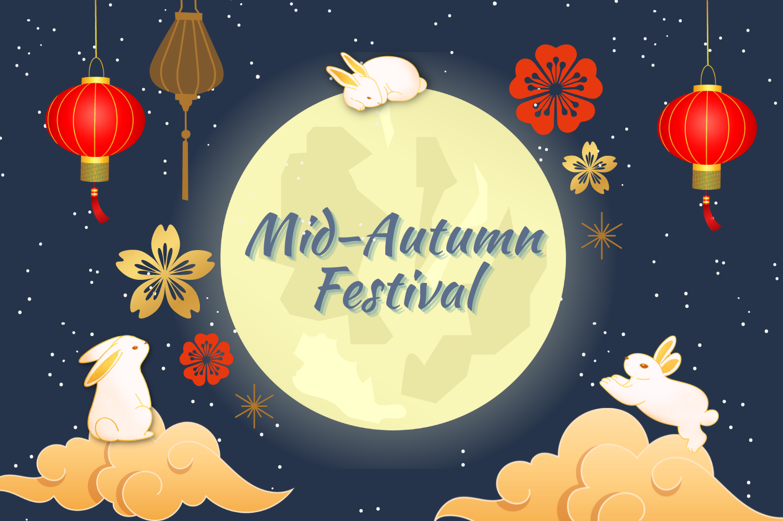
By Lucas Gobaco

Slide 3
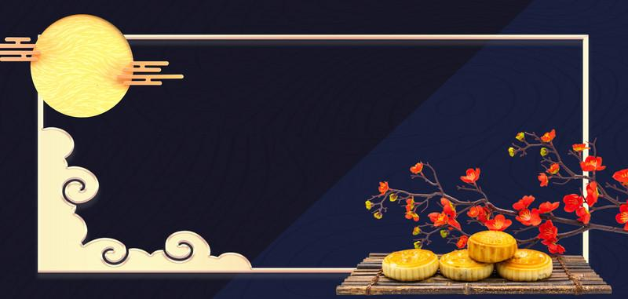
What is the
Mid-Autumn Festival?

Slide 4
How is it celebrated?

Slide 5
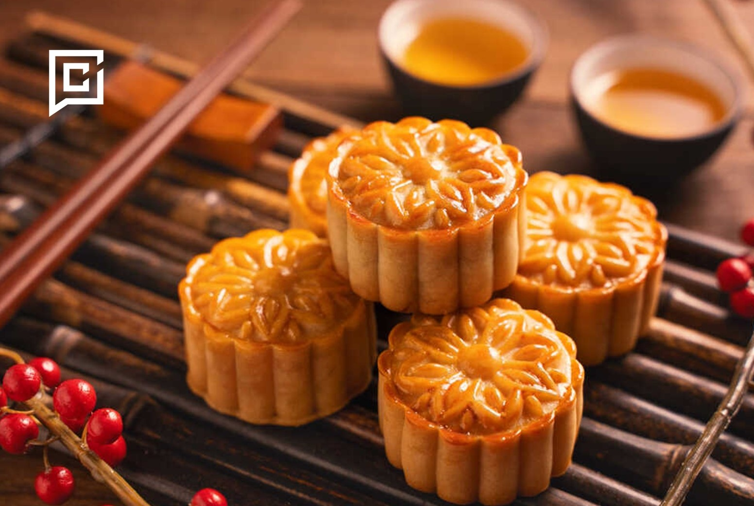

Slide 6
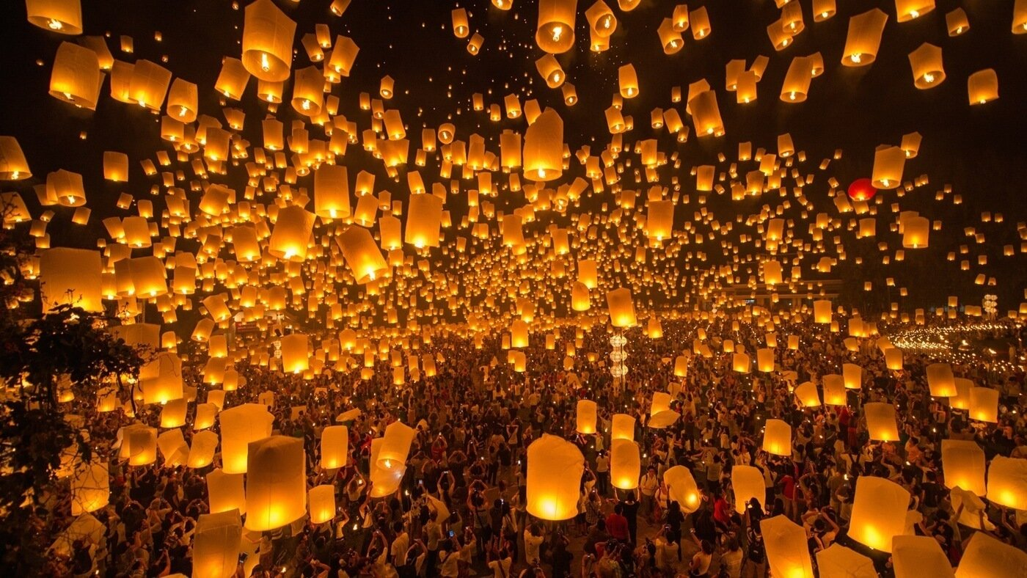

Slide 7
What is the Mooncake Dice Game?

Slide 8
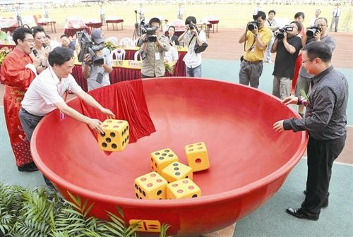

Slide 9
How it is played:
https://youtu.be/skzN8_N6srs?si=H7uDtyBS18bCkjnF&t=48

Slide 10
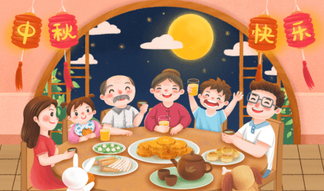

Slide 11
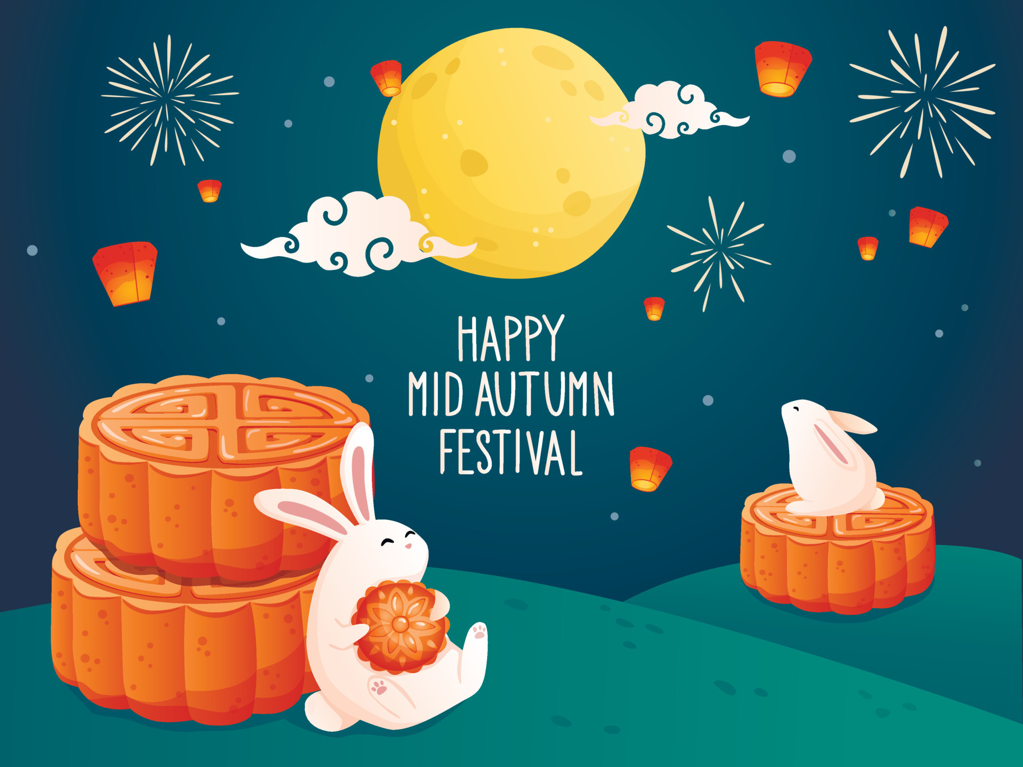
Thanks for listening!
Thanks for listening!

Slide 12
References
Bo Bing (game). (2024a). Retrieved from https://en.wikipedia.org/wiki/Bo_Bing_(game)
Mid-Autumn Festival. (2024b). Retrieved from https://en.wikipedia.org/wiki/Mid-Autumn_Festival
See, T. A. (2022). Roll the dice... it’s Mooncake Time. Retrieved from https://tulay.ph/2022/09/10/roll-the-dice-its-mooncake-time/
Tan, B. (2018). Mid-autumn Festival (Zhong Qiu Jie). Retrieved from https://www.nlb.gov.sg/main/article-detail?cmsuuid=9907c553-19b3-4168-a613-49d35f2893ae
Watkins, S. (2023). Everything you need to know about the Mid-Autumn Festival - Mandarin Matrix. Retrieved from https://mandarinmatrix.org/mid-autumn-festival-traditions-and-activities/
Yeromiyan, T. (2024). China’s Mid-Autumn Festival (2022): Family, friends, and harvest. Retrieved from https://studycli.org/chinese-holidays/mid-autumn-festival/

